Slide 1
“ ok glass ”
Notes:
Hello :D

Slide 2
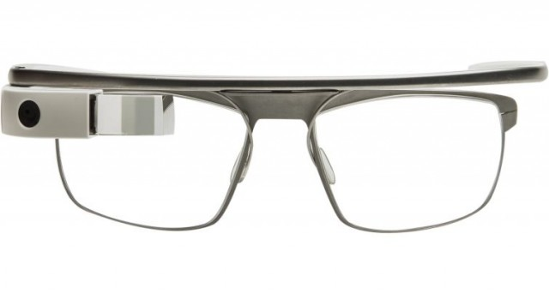
Google Glass
5MP Camera
720p Video
12GB Hard Drive
1GB Total Ram
Accelerometer
Gyroscope
Magnetometer
Notes:
Quick general overview
682MB available
A lot of space
Quite warm
Compass

Slide 3
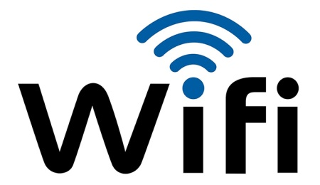


Connection
Android
Google servers
Voice recognition
My Glass App
Stream viewpoint
Notes:
Two types of voice recognition
Pair with → GPS
Stream everything user sees
Google +
Bluetooth battery

Slide 4
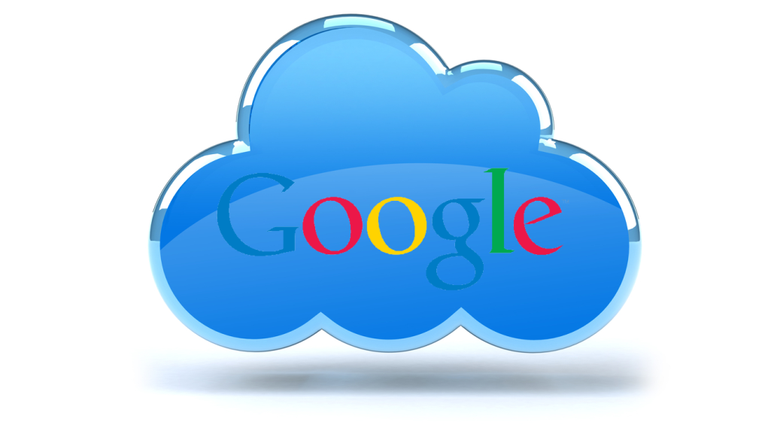



API
Mirror API
Server side
Timeline messages
Stream videos
Share videos
Virtual contact
Notes:
Original API
Social media and news
No installation
Sign up with Google account
Json
Google Apps framework
Reply

Slide 5

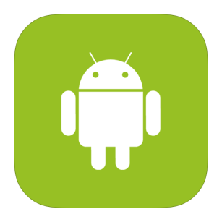
API
Glass Development Kit
Native apps
Access to sensors
Full control
Sideload
Android SDK
Notes:
Much more powerful
Beta → updates
Easy if you know android
Set up Bluetooth manually
Must be manually launched

Slide 6

Comparison
GDK
Harder networking
Backwards incompatibility
Full control
Mirror API
Easier networking
No installation
No direct control
Notes:
Both good at respective fields
Depends on what you need to do
Wouldn’t discount Mirror, but SDK definitely more powerful

Slide 7
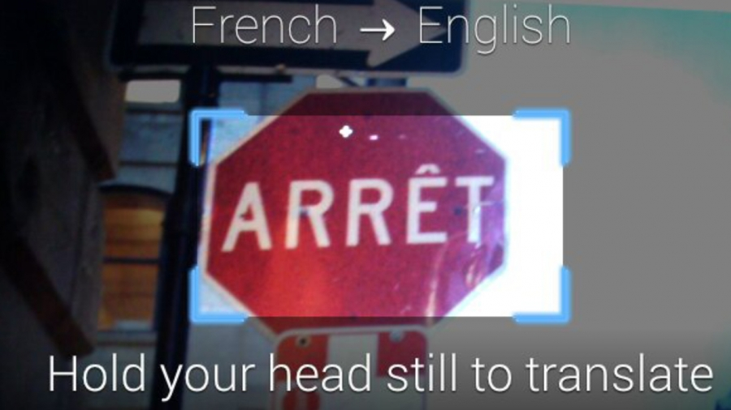
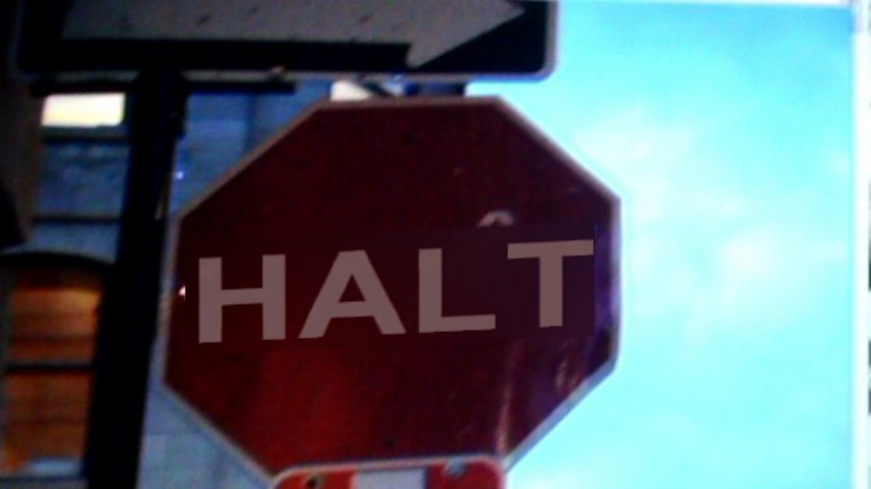
Applications
Translate in place
Notes:
One of the coolest apps I’ve seen

Slide 8
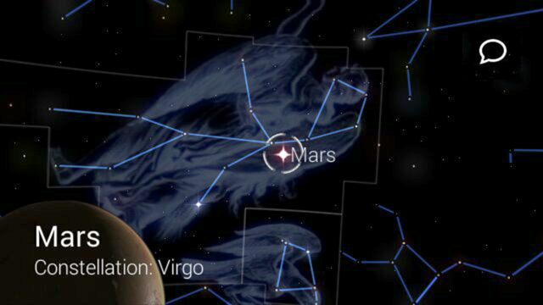
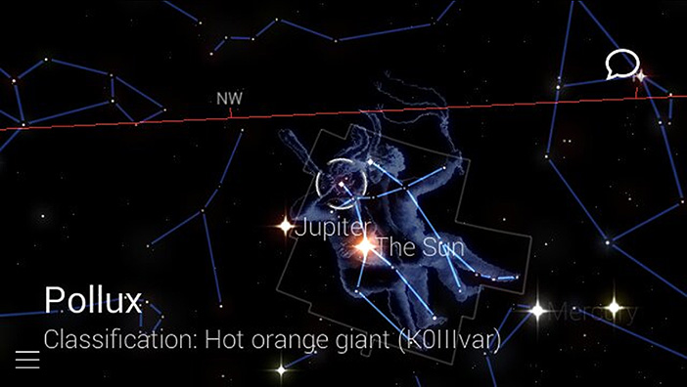
Applications
Translate in place
Interactive star chart
Notes:
Lets you look around
Reads aloud

Slide 9
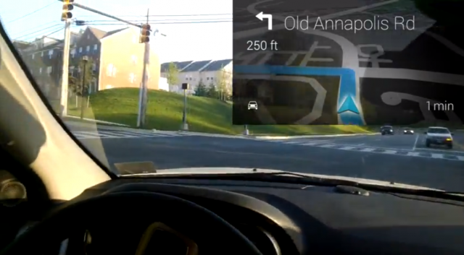
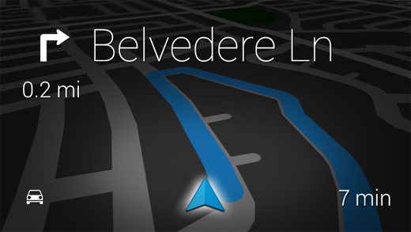
Applications
Translate in place
Interactive star chart
Live directions
Notes:
Automatically orients

Slide 10
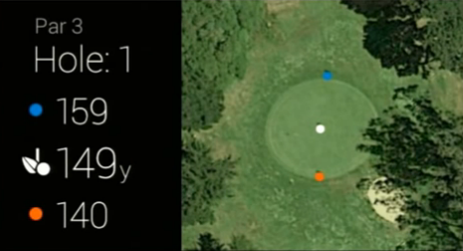
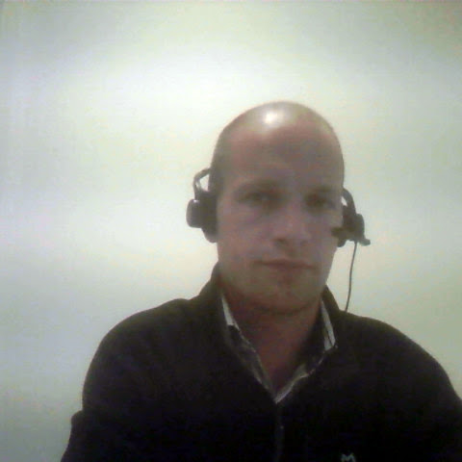
Applications
Translate in place
Interactive star chart
Live directions
Golf
Notes:
I guess it can find golf courses too

Slide 11
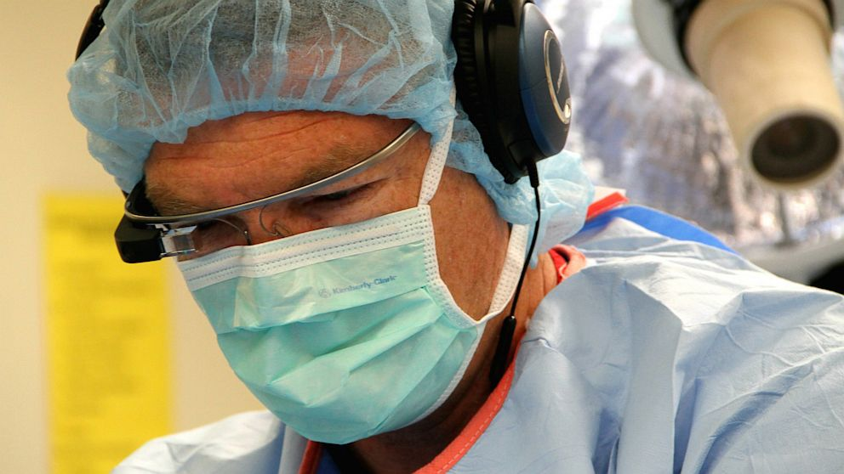
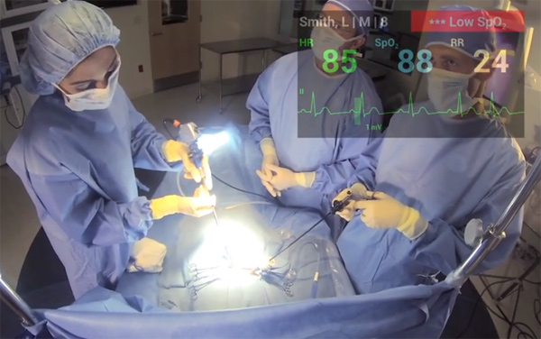
Applications
Translate in place
Interactive star chart
Live directions
Golf
Surgery
Notes:
The main thing we’ve been focusing on
A lot of other people
Live streaming
Huddled around
Heart monitor

Slide 12
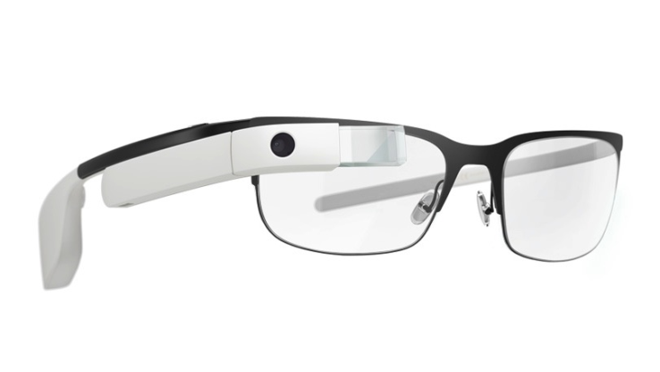
Glass
Glass Developer Kit
Mirror API
Interesting usages
Specific professions
Notes:
Two kits → depending on what you need to do
I can imagine → professionals
Whether it’ll kick off socially – I don’ know.
Privacy

